Slide 1
Autonomous Car
BY ENG: Mohamed Abdullah Ahmed Mousa
Group:D32

Slide 2
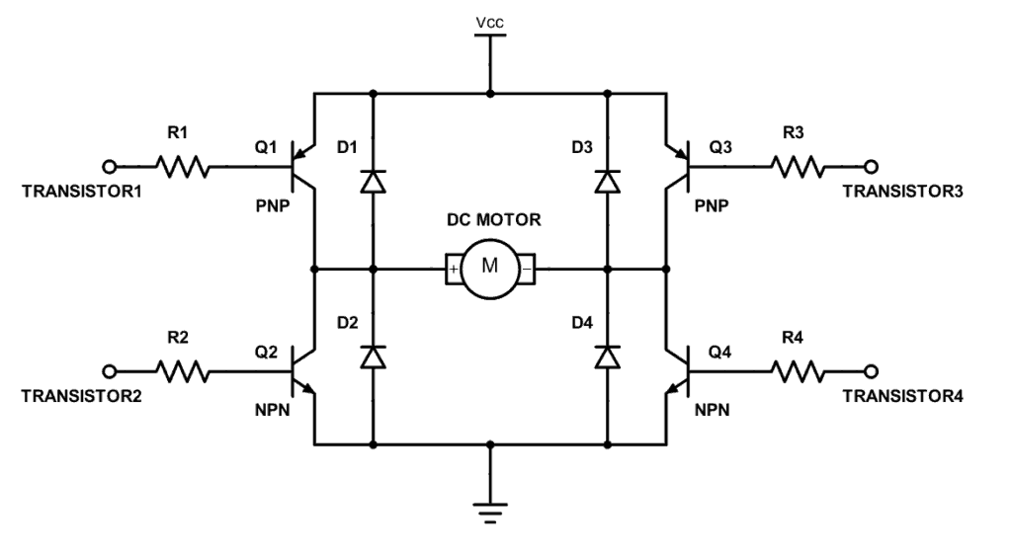
Motor Driver
❖H-Bridge:is an electronic circuit that enables a voltage to be applied across a load in either direction. These circuits are often used in robotics and other applications to allow DC motors to run forwards or backwards

Slide 3
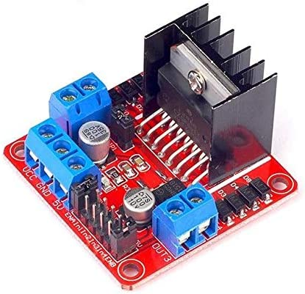
Motor Driver
❖L298 Dual H Bridge Module
Features:
1- Motor Supply: 7 to 24 dc
2- Control Logic: Standard TTL Logic Level
3- Output Power: Up to 2 A
4- Enable and Direction Control Pins
5- Module 5V (VCC) to Microcontroller 5V Pin
6- Module GND Microcontroller GND Pin
7- Module 12V To external Power source

Slide 4
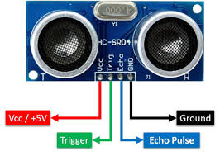
HCSR04 Ultrasonic Sensor
❖ HCSE04 Ultrasonic Sensor:
It is used To get Distance Forward, Distance of Right side and Distance of Left side

Slide 5
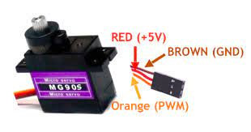
Servo Motor
❖ MG90S Micro Servo Motor :
It is used to move the servo left and right

Slide 6
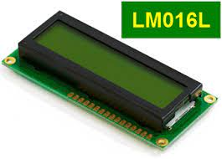
LCD
❖ LM016L LCD :
it is used for display distance and direction of car

Slide 7
Timers
❖TIMER0: used to control a servo motor
Working In: Fast PWM , 256 Prescaler , Non inverting mood
compare value= ((ICR1 * angle) / 100) – 1 ICR1 =1250
❖ TIMER1: used to calculate On Time of ECHO pin in HCSE04 Working In: Normal Mode , NO Prescaler , Compare value = 250
❖ TIMER2: used to Generate PWM to control of speed of motors by used L298D Working In: FAST PWM Mode , output compare on (OC2) , Prescaler = 64 , Compare value = 100

